Slide 1

AEDA: An Easier Data Augmentation Technique for Text Classification
Submitted By :
Abhishek Dobhal 2K21/AFI/01
Alok Pandey 2K21/AFI/11

Slide 2
Introduction
TEXT CLASSIFICATION :
In natural language processing, text classification is a crucial task (NLP). Machine learning and deep learning have achieved high accuracy on tasks ranging from sentiment analysis to topic classification, but excellent performance is frequently dependent on the number and quality of training data, which may be time-consuming to gather.
DATA AUGMENTATION :
If there is insufficient labelled data for training in many machine learning (ML) applications and domains, data augmentation (DA) can be used to increase the performance of such machine learning systems.
For the data augmentation in image classification task, methods like rotating the image, zooming in the image, changing the angles, smearing the image etc. are used to improve the performance of the model and reduce overfitting.
Various methods that can be used to carry out data augmentation include altering elements of the input sequence like word substitution, deletion, insertion and back translation or injecting noise into the input sequence.

Slide 3
Literature Survey
Wang and Yang (2015) substitute words with their synonyms for classifying tweets.
Sennrich et al. (2016) utilize back-translation to train a neural machine translation system using automatically translated data as well as the original human-translated data.
Fadaee et al. (2017) utilize substitution of common words with rare ones, thus providing more context for the rare words.
Andreas (2020) creates new sentences by replacing sentence fragments from similar categories with each other.
Some researchers have opted for using pre-trained language models such as BERT.

Slide 4
Libraries
Numpy
Pandas
SkLearn
Keras
TensorFlow
Nltk
Matplotlib

Slide 5
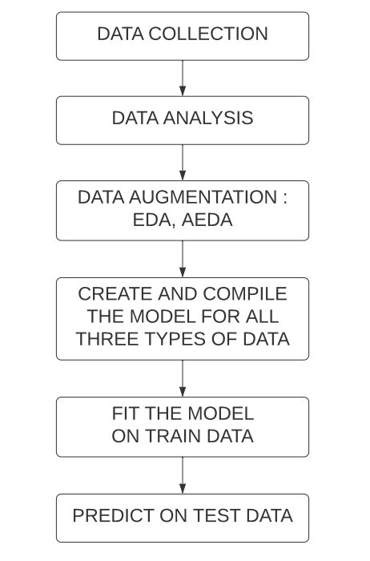
FLOW OF WORK

Slide 6
Datasets Used
CR (Customer Reviews Dataset)
PC (Pros and Cons Dataset)
SST-2 (Standford Sentiment Treebank)
SUBJ (Subjectivity/Objectivity Dataset)
TREC (Question Classification Dataset)

Slide 7
Dataset | No. of Classes | Average sentence length | No. of training samples | No. of test samples | No. of unique words
SST-2 | 2 | 19 | 7791 | 1821 | 15771
CR | 2 | 19 | 4067 | 451 | 9048
SUBJ | 2 | 25 | 9000 | 1000 | 22715
TREC | 6 | 10 | 5452 | 500 | 9448
PC | 2 | 7 | 40000 | 5806 | 26090
Table 1. Statistics of the utilized datasets

Slide 8
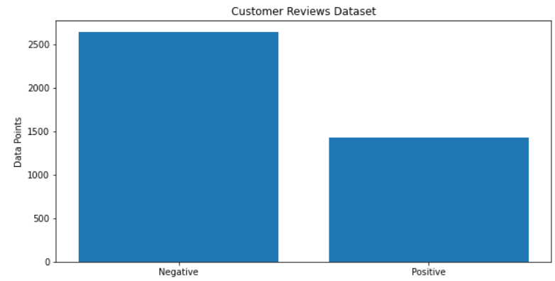
Customer Reviews Dataset
Figure 1. Customer Reviews Dataset
Positive examples: 1. When I opened the box, I was shocked by the size of this thing... It's TINY!
2. The controls are on the side instead of on the front , which i like , because that 's where my thumb is when i hold the thing !
Negative Examples: 1.While the software may not be as easy as I-Tunes, it is not difficult to use by any stretch.
2. 3/4 way through the first disk we played on it ( naturally on 31 days after purchase ) the dvd player froze .

Slide 9
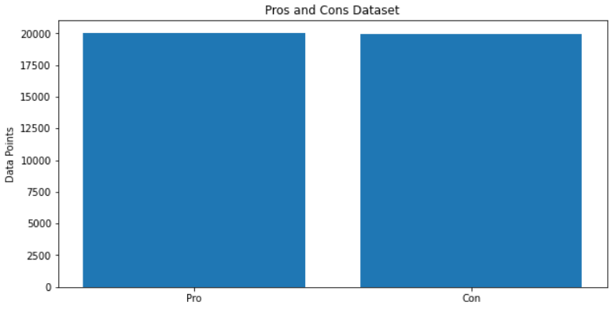
Pros and Cons Dataset
Figure 2. Pros and Cons Dataset
Pro examples: 1. Price, Good Picture Quality, Ease of use.
2. Cheap and great resolution for digital photography and graphics
Con Examples: 1.can't download ringtones
2. ink cartridge runs out very quickly

Slide 10
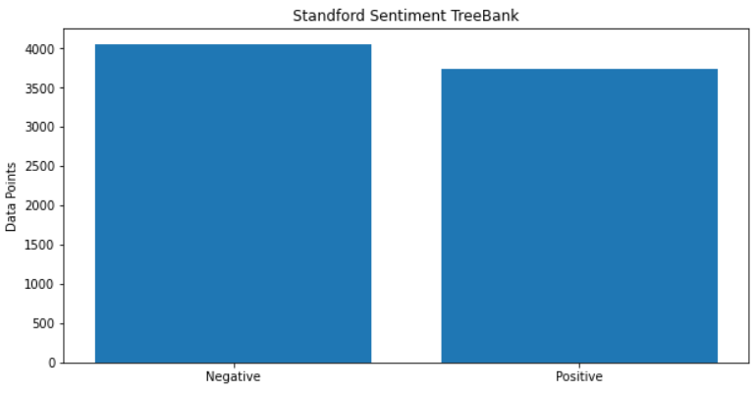
Standford Sentiment TreeBank
FIgure 3. Standford Sentiment TreeBank Dataset
Positive examples: 1. this is one of polanski's best films .
2. campanella gets the tone just right -- funny in the middle of sad in the middle of hopeful .
Negative Examples: 1.no movement , no yuks , not much of anything .
2. gangs of new york is an unapologetic mess , whose only saving grace is that it ends by blowing just about everything up .

Slide 11
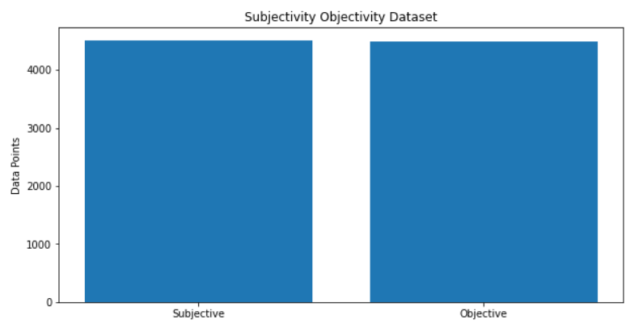
Subjectivity Objectivity Dataset
Figure 4. Subjectivity Objectivity Dataset
Objective examples: 1. paravasu is the elder son of the great sage raibhya ( mohan agashe ) .
2. as they make their way to the city from suburban pennsylvania , april must endure a comedy of errors - like finding out her oven doesn't work - in order to pull off the big event .
Subjective Examples: 1.sunk by way too much indulgence of scene-chewing , teeth-gnashing actorliness .
2. swiftly deteriorates into a terribly obvious melodrama and rough-hewn vanity project for lead actress andie macdowell .

Slide 12
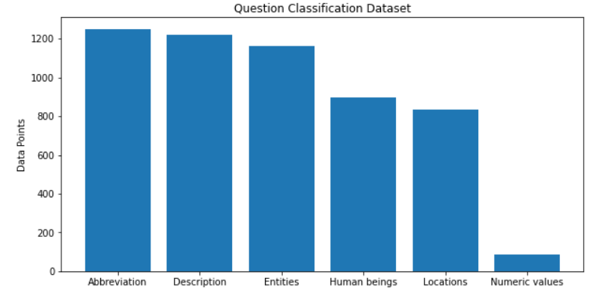
Question Classification Dataset
Figure 5. Question Classification Dataset

Slide 13
EDA
We perform four augmentations for each sentence, one corresponding to each of the following techniques.
Synonym Replacement (SR) : Choose 10% words out of the total number of words in the sentence and replace them with their synonyms.
Random Insertion (RI) : We have randomly inserted 10 percent words out of the total number of words in a sentence.
Random Swap (RS) : For 10 percent of the words out of the total number of words in a sentence, we have randomly chosen another word and replaced the two.
Random Deletion (RD) : We have randomly deleted 10 percent of the words out of the total number of words with a probability of 90 percent in a sentence.

Slide 14
Synonym Replacement
Convert the sentence into words.
Shuffle the words
Select the first word not yet selected, find it’s synonym, replace the synonym with the actual word.
Repeat the above process for the number of replacements to be done.
Return the Augmented word list

Slide 15
Random Deletion
Convert the sentence into words
For each word, get a uniform value
If this value is greater than the probability value then delete the word, and return the updated list
Else continue

Slide 16
Random Swap
Convert the sentence into words.
Randomly Select two unique words from the word list.
Swap the positions for the words in the word list.
Repeat 2 and 3 until we complete the number of replacements needed.
Return the updated words list

Slide 17
Random Insertion
Convert the sentence into a list of words.
Randomly select a word from the list of words, that has already not been selected.
Get the synonyms for the selected word.
Select the first synonym from the selected list of synonyms for the word.
Add this synonym to a randomly selected index.
Repeat this step for the number of times insertion has to be done.
Return the updated list of words

Slide 18
EXAMPLES OF EDA
ORIGINAL DATA : i must have heard this about a dozen times over the span of weeks when t zones never worked
RANDOM INSERTION : i must have heard this about a birth dozen times over the span of weeks when t zones never worked
RANDOM SWAP : i must have about this heard a dozen times over the span of weeks when t zones never worked
RANDOM DELETION : i heard this about a dozen times over the span of weeks when never worked
SYNONYMS REPLACEMENT : i moldiness have heard this about a dozen times over the span of weeks when t zones never worked

Slide 19
AEDA
We perform four augmentations for each sentence.
First convert the sentence into individual words.
Out of the six punctuation marks ['.', ',', '!', '?', ';', ':'] , we randomly select a punctuation to add to the sentence at any random position in the sentence.
Return the list of the updated sentences.

Slide 20
EXAMPLES OF AEDA
ORIGINAL : i must have heard this about a dozen times over the span of 2 weeks , when t-zones never worked .
AUGMENTATIONS :
i must have ! heard this about a dozen times over the span of 2 weeks ; , ! when t-zones never worked .
i must have ? heard this about . a dozen times ; over ? the span of 2 weeks , when ! t-zones never worked ; .
i must have heard this , about a dozen times , over the span of 2 weeks , when t-zones never worked .
i must have heard this about a dozen times over the span of 2 weeks , when t-zones never : worked .

Slide 21
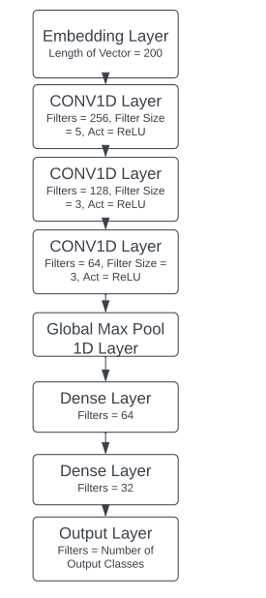
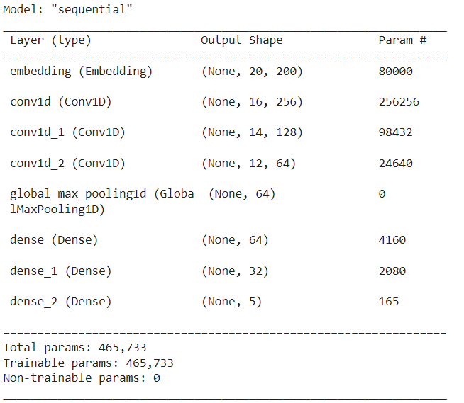
MODEL

Slide 22
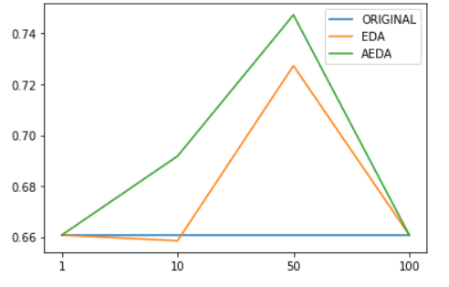
Result On Customer Reviews Dataset

Slide 23
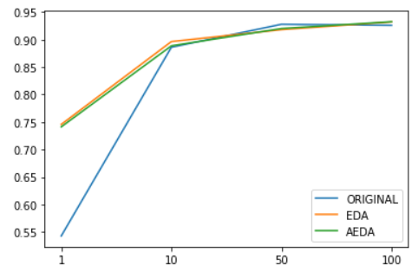
Result On Pros and Cons Dataset

Slide 24
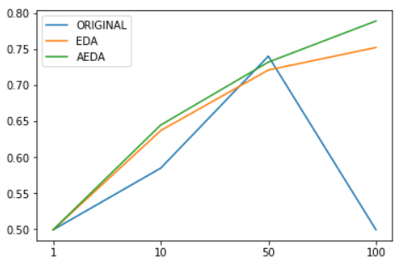
Result On Standford Sentiment Treebank Dataset

Slide 25
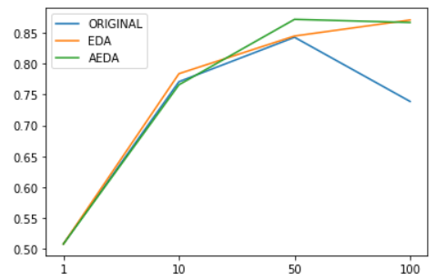
Result On Subjectivity Objectivity Dataset
SUBJ

Slide 26
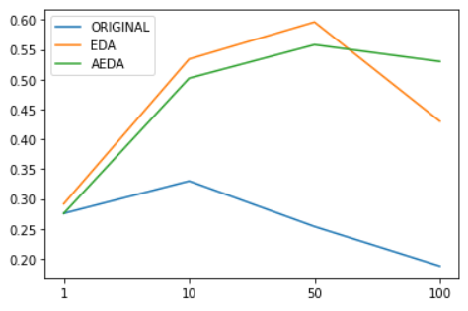
Result On Question Classification Dataset

Slide 27
CONCLUSION
There is not much of a difference for larger dataset
Delay and Reduce Overfitting for larger dataset
Same level of performance as EDA with simpler work

Slide 28
REFERENCES
[1]. Akbar Karimi Leonardo Rossi Andrea Prati, 2021, AEDA: An Easier Data Augmentation Technique for Text Classification.
[2]. Jason Wei1, Kai Zou, 2019,EDA: Easy Data Augmentation Techniques for Boosting Performance on Text Classification Tasks
https://github.com/akkarimi/aeda_nlp/tree/master/data

